Slide 1
OPERATION SECURITY USING PFSENSE AND SNORT
01

Slide 2
CREATOR’S INTRODUCTION
Muhammad Affan Burney
Affanburney03@gmail.com
IEC Cohort 4
Portfolio Project No.1
https://www.linkedin.com/in/affan-burney-056485194/
02

Slide 3
PROJECT IDEA
This project is devoted to presenting a solution to protect web pages that acquire passwords and user names against HTML brute force . By performing a brute force password auditing against web servers that are using HTTP authentication with Nmap and detect this attack using snort IDS/IPS on PFSense Firewall .
pfSense is a firewall/router computer software distribution based on FreeBSD. The open source pfSense Community Edition (CE) and pfSense Plus is installed on a physical computer or a virtual machine to make a dedicated firewall/router for a network.
03

Slide 4
Project Management
1
Analysis & Design
2
Development
3
Testing
4
Documentation
04

Slide 5
01
Analysis & Design
1. Draft environment
2. Install needed ISO
05

Slide 6
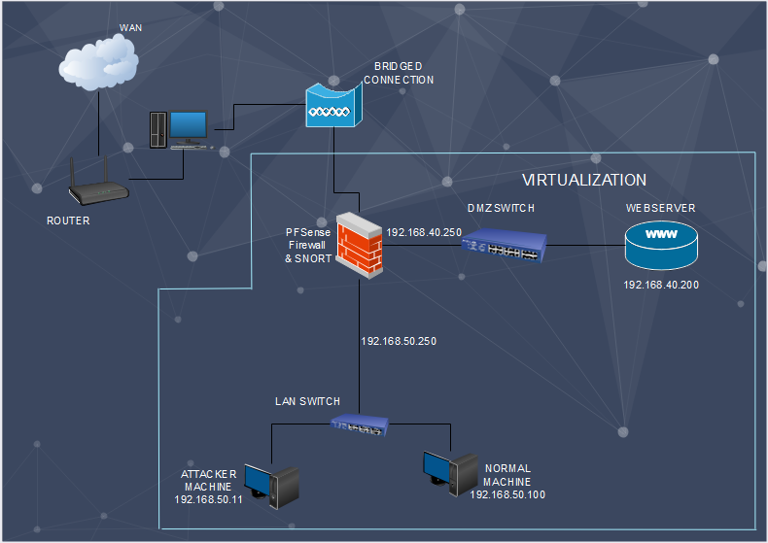
Environment
06

Slide 7
02
Development
1.
Setup the environment
Install Snort on PFSense as an Intrusion Prevention System
Configure Snort to defend against the HTTP Brute Force Attack
2.
3.
07

Slide 8
MY WORK
Setup The Environment
Setup Virtual Switches in VMWare Workstation .
Setup Victim Webserver machine .
Setup Attacker machine .
Setup normal user machine .
Setup PFSense Firewall .
08

Slide 9
MY WORK
INSTALL SNORT on PFSENSE
Install Snort package .
Download Snort VRT rules .
CONFIGURE SNORT
Configure Snort on interfaces to defend against the HTTP-BRUTE FORCE attack .
09

Slide 10
03
Testing
1.
Perform HTTP-BRUTE FORCE attack .
Checked alert and blocked host .
2.
10

Slide 11
MY WORK
PERFORM HTTP-BRUTE FORCE ATTACK
By using Nmap tool on Kali Linux ( Attacker Machine)
11

Slide 12
04
Documentation
1.
Write a Report .
12

Slide 13
REFERENCES
https://www.freecodecamp.org/news/what-is-a-virtual-machine-and-how-to-setup-a-vm-on-windows-linux-and-mac/
https://turbofuture.com/internet/How-to-Set-Up-an-Intrusion-Detection-System-Using-Snort-on-pfSense-20
https://www.snort.org/
https://pfsense.org/
https://hub.packtpub.com/brute-forcing-http-applications-and-web-applications-using-nmap-tutorial/
13

Slide 14
THANKYOU
14

